Slide 1
WELCOME TO DAC-BOARD-PORTAL

Slide 2
Project Team
Sr.No. | Name | PNR
1 | Mali Komal | 210930920025
2 | Nikam Rohini | 210930920031

Slide 3
Content
Problem Statement
Proposed Solution
Scope of project
Hardware and software requirements
Conclusion

Slide 4
Problem Statement
Now-a-days due to pandemic situation ,the whole world moved towards virtual mode.
The students who are learning through online platforms , there are some of the issues due to lack of interactivity. And one of the major factor is that all the data for their classes are scattered , which makes it difficult to find each and every session recording, schedule and many more.
Due to this ,the time utilization is more in searching rather than studying.

Slide 5
Proposed Solution
To overcome this problem we have designed
DAC-BOARD , a web-portal where the DAC students can register through their Id’s and check out the details regarding their online sessions such as they can visit recordings as per schedule in one platform itself and can access the details of future scheduled lectures.
With the help of this portal students can save time in searching data through what’s app or any other applications.

Slide 6
Scope of Project
The scope of this project is focused on designing and implementing a web based system for DAC-BOARD using innovative technology as a significance tool to provide user friendly and secure application for the Institute as well as Students.

Slide 7
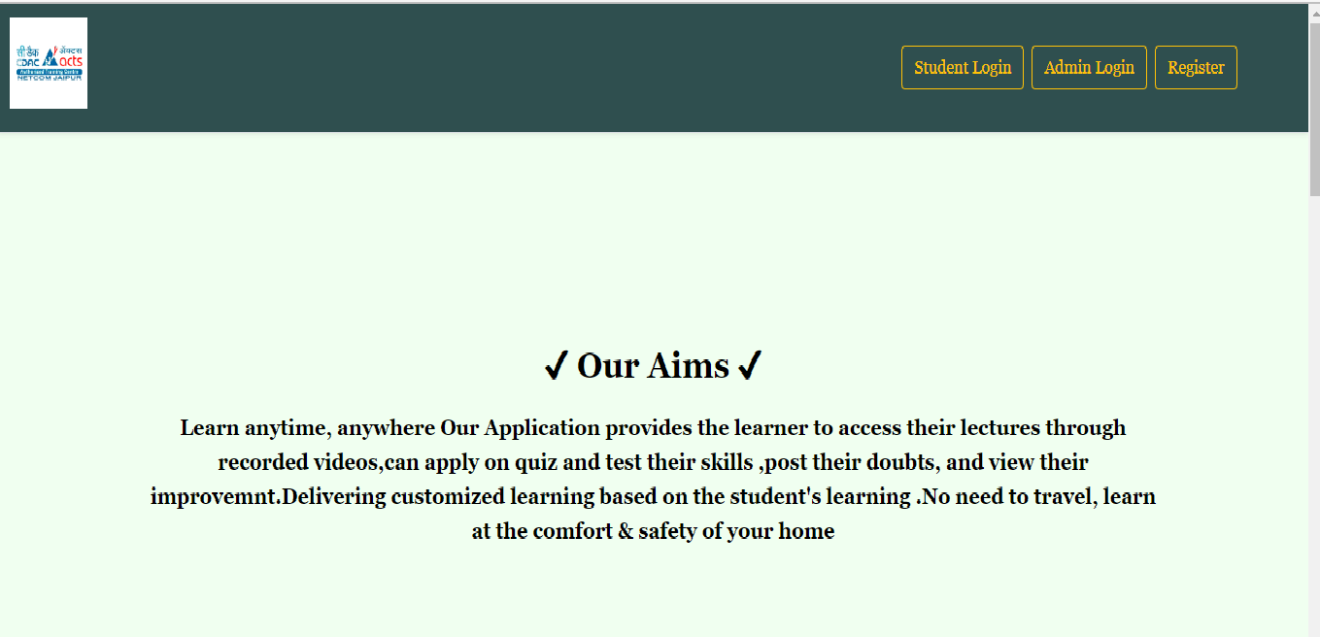
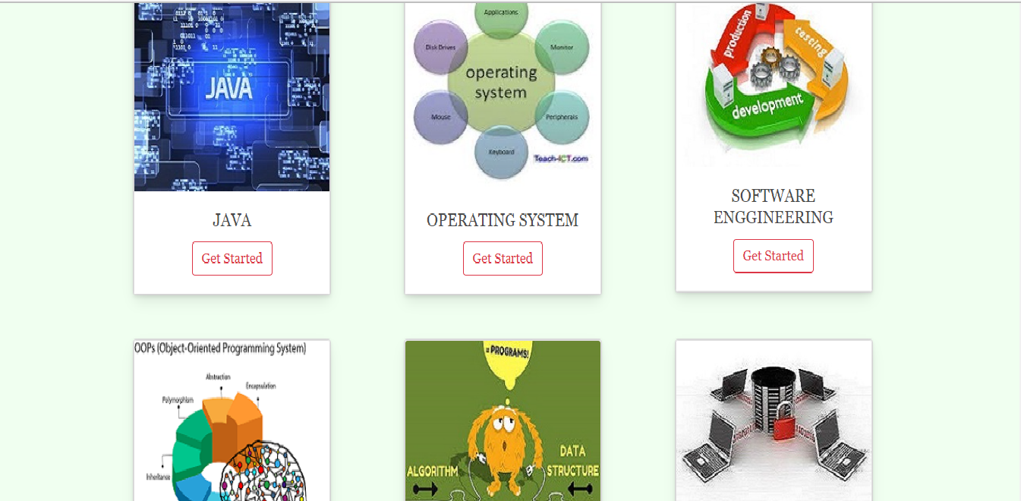
Services:
1.Front Page
Pic : 1. Front Page

Slide 8
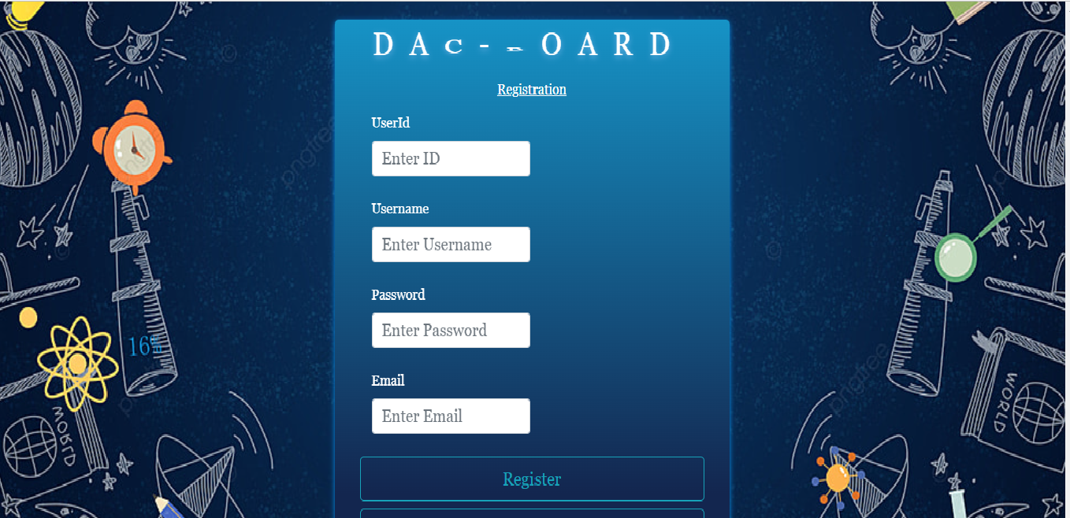
2. Student Registration Page

Slide 9
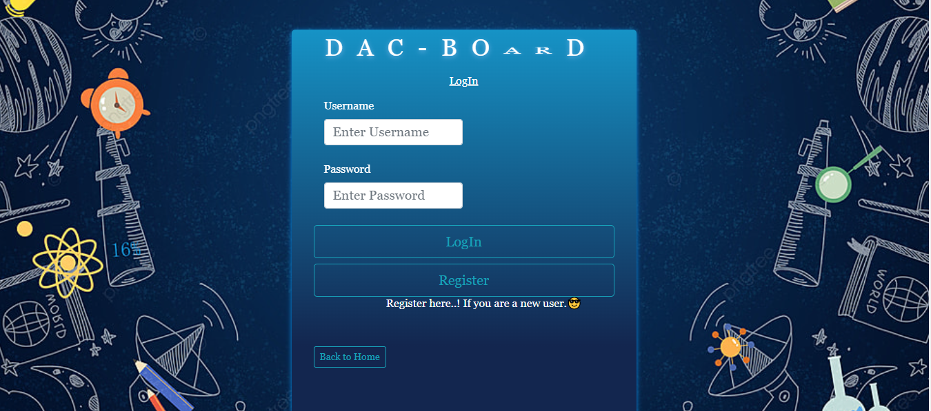
3. Student Login Page

Slide 10
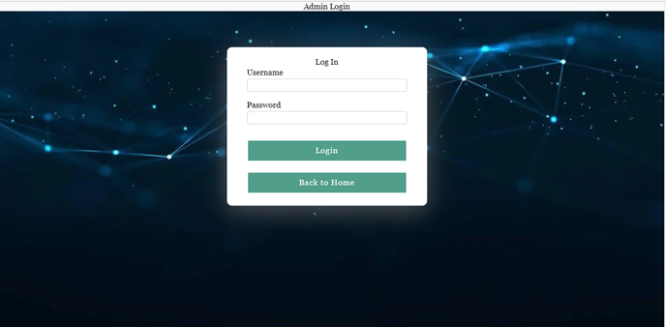
4. Admin Login Page

Slide 11
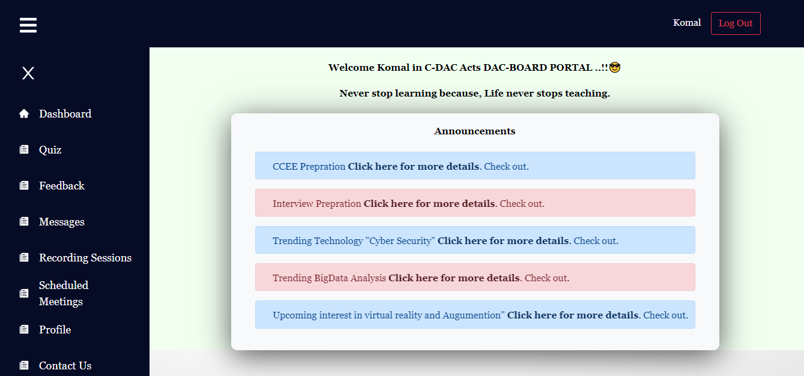
5.Student Dashboard

Slide 12
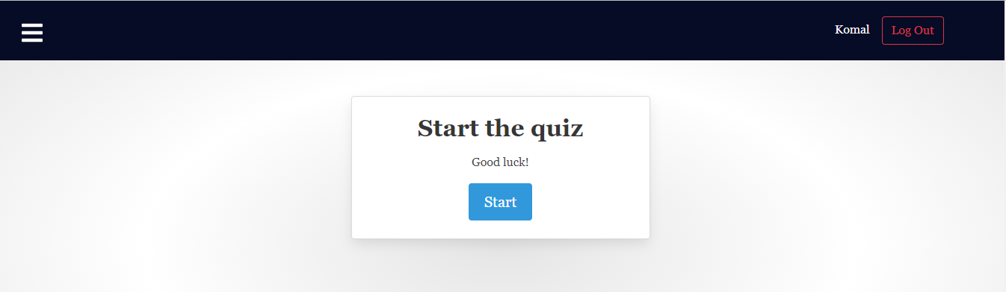
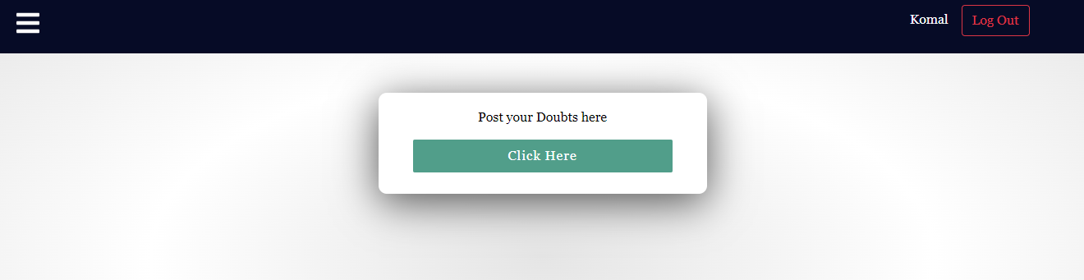
6. Quiz
7. Student Doubt Section

Slide 13
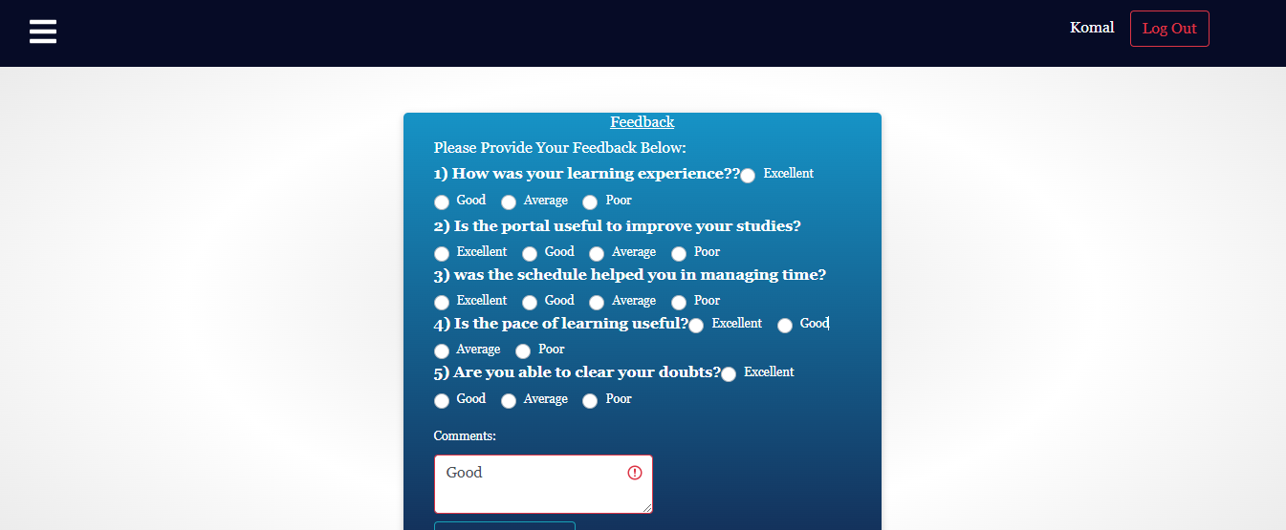
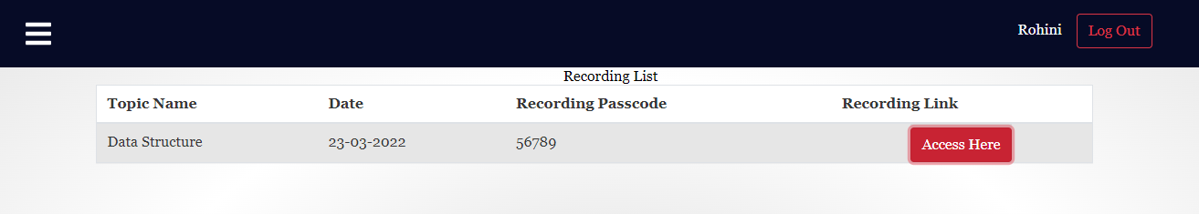
8.Student Feedback Section
9. Recorded Sessions

Slide 14
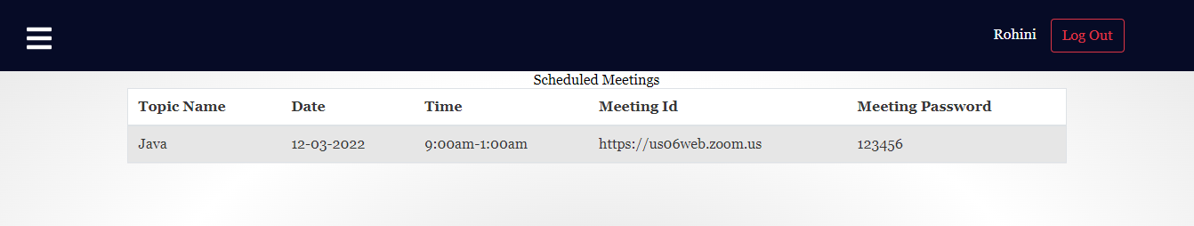
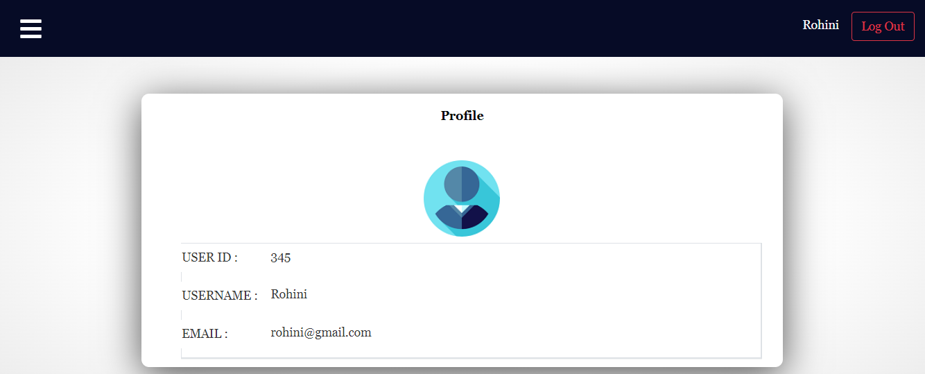
10.Scheduled Meeting Sessions
11. User Profile

Slide 15
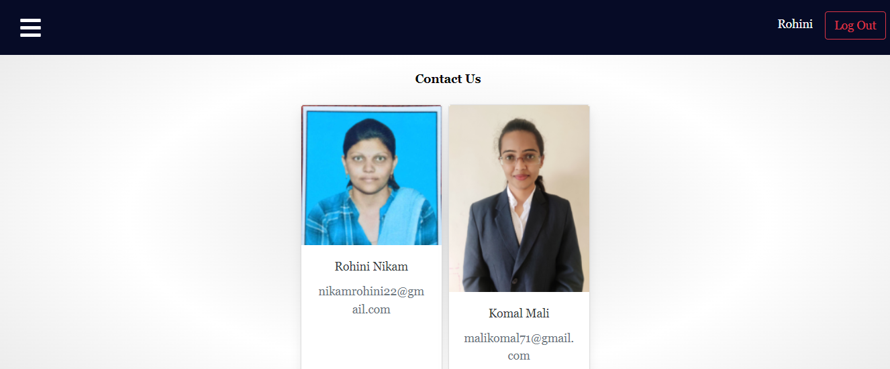
12. Contact Details

Slide 16
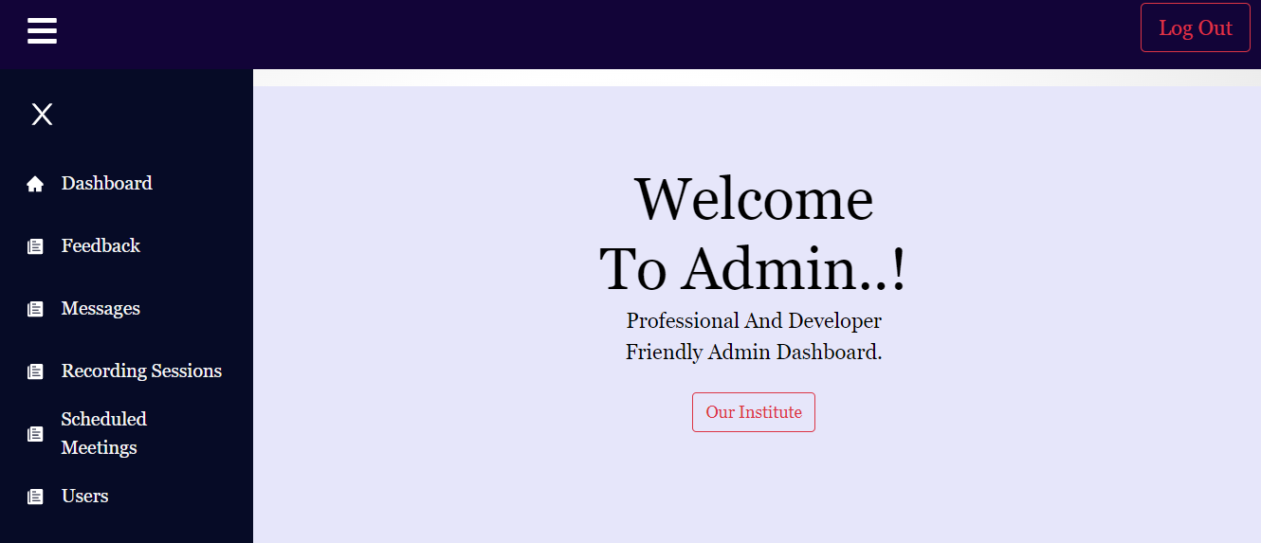
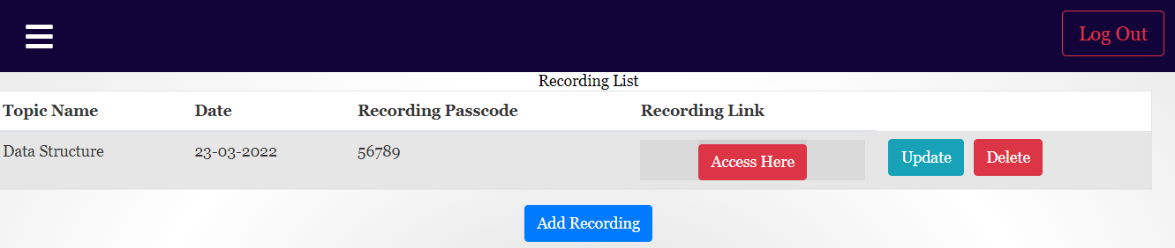
13 .Admin Dashboard
14. Admin Recordings list

Slide 17
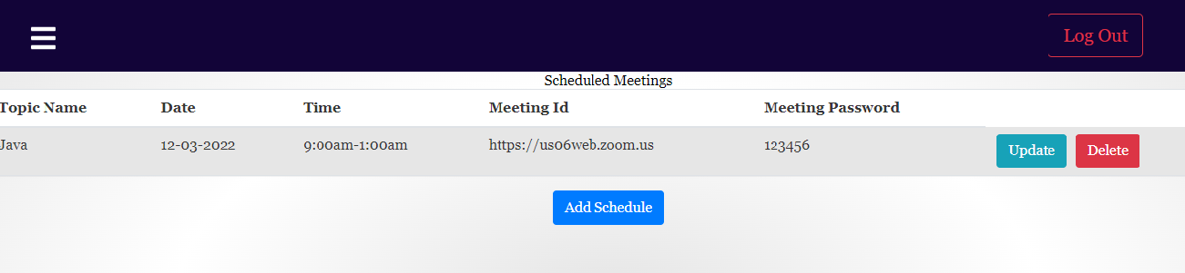
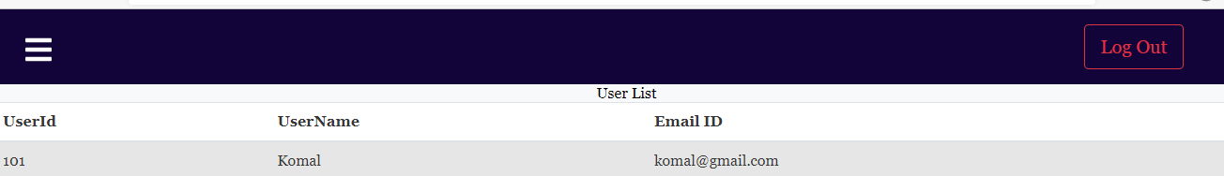
15. Admin Schedule For Meeting
16. User List

Slide 18
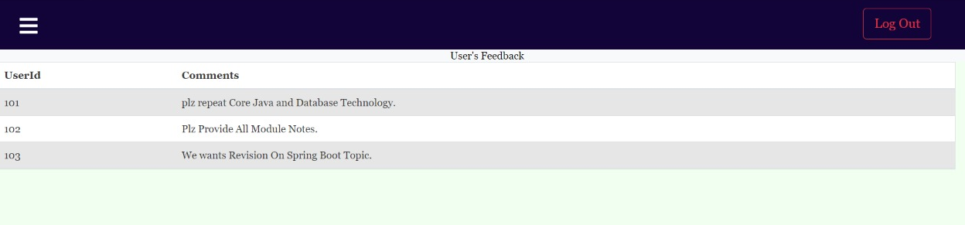
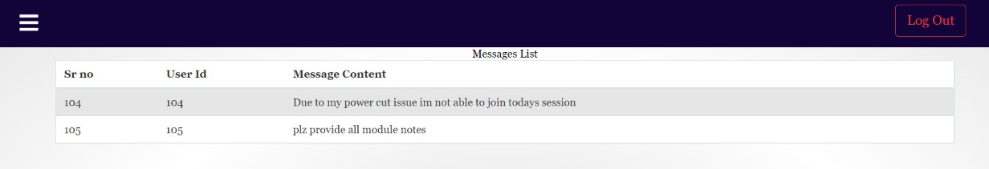
17. Admin Feedback
18 . Admin Message Box

Slide 19
Hardware & software requirements
Front-End : HTML5, CSS3 ,JavaScript, Bootstrap, ReactJS
Back-End : J2EE
Database : MY-SQL.

Slide 20
Conclusion
DAC-BOARD- , a web-portal where the DAC students can register through their Id’s and check out the details regarding their online sessions such as they can visit recordings as per schedule in one platform itself and can access the details of future scheduled lectures.
With the help of this portal students can save time in searching data through what’s app or any other applications.

Slide 21
Reference
https://javatpoint.com
https://studentprojectguides.com
https://classroom.com
https://w3tschool.com
https://blogprototype.com

Slide 22
Thank You!

